Slide 1
DEVELOPMENT OF A DYNAMIC CURRENCY MANAGEMENT WEB APPLICATION
GitHub Repository: [https://github.com/roshanmaandiya/Web-Development-DLBCSPJWD01-].

Slide 2
Purpose of the Web Application
The Currency Management Web Application includes current currency rates for currency tracking and management. Bearing in mind the audience as financial analysts, travelers and forex managers, the app is characterized by the opportunity of the convenient and efficient exchange rate control and adjustment to provide fast and reasonable decision-making and improved operational with the financial data.
Notes:
SN: Travelers, forex managers and financial analysts are the beneficiaries of this application since they get real time currency rate along with better management of data input coupled with quick change in currency rates to make a better decision.

Slide 3
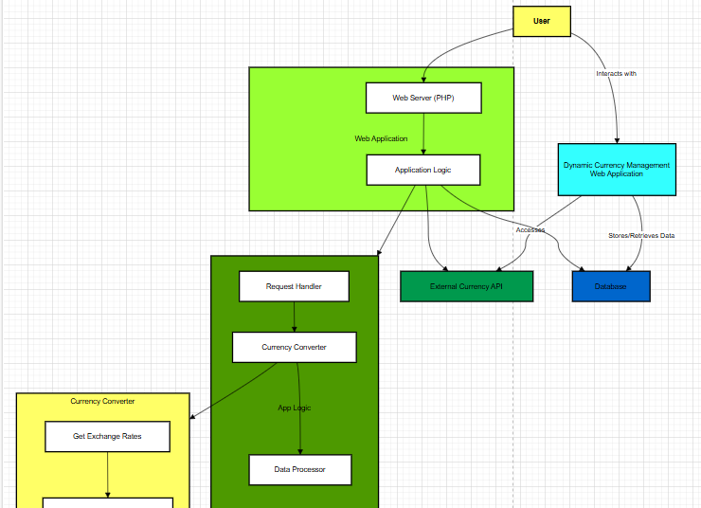
Architecture Diagram
HTML lays out the application, CSS beautifies it, and Ajax gets the content (Odeniran, 2023).
PHP is responsible for the form data processing and MySQL is responsible for storing currency rates.
Front-end communicates with the back-end through PHP which transmits data both to and from the MySQL base.
The design of the system supports front-end and back-end to combine for allowing user-friendly interactions.
Notes:
SN: The architecture described here is clean and it effectively separates concerns between front and back ends. The main or outer part is the front-end which has to do with the actual users and the inner or back-end which deals with data.

Slide 4
Overview of technology choices
Technologies to be used in the front end as well as back end is decided upon.
For instance, we chose HTML, CSS, JavaScript to build an intuitive user interface to display and manage currency rates, and PHP, MySQL to do the back-end form submission and storage of the currency data in the database.

Slide 5
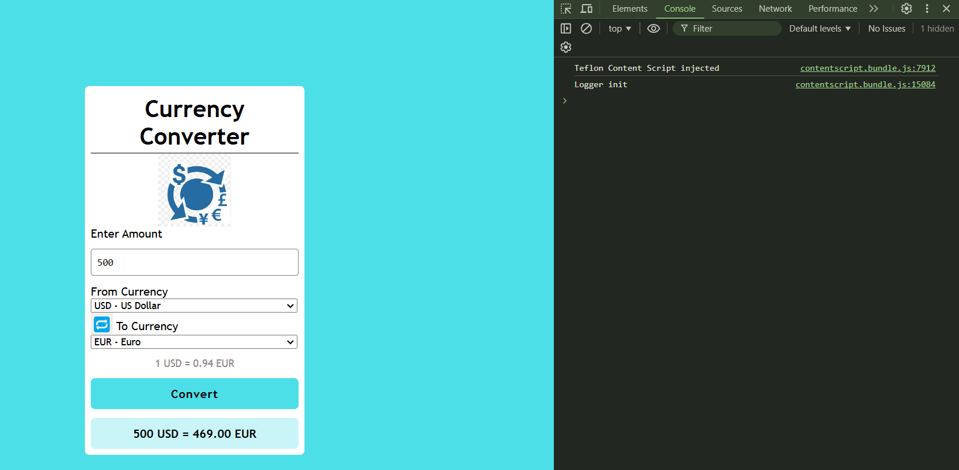
Test Case 1: Currency Conversion Functionality
It’s also important to check that the “Convert From” and “Convert To ” drop downs have the right currencies (like USD and EUR).
Enter only valid positive number ie a whole number greater than 0 (e.g 100) to transform.
Press “Convert” and show the converted sum with the rate.
This should be double checked against a trusted source to ensure that it has not got any error.
Notes:
SN: To see how it works, select desired currencies, input an amount of money and press ‘Convert’. Check that the result is correct concerning real-time rates, and look into the console for any issues to avoid disruptions.

Slide 6
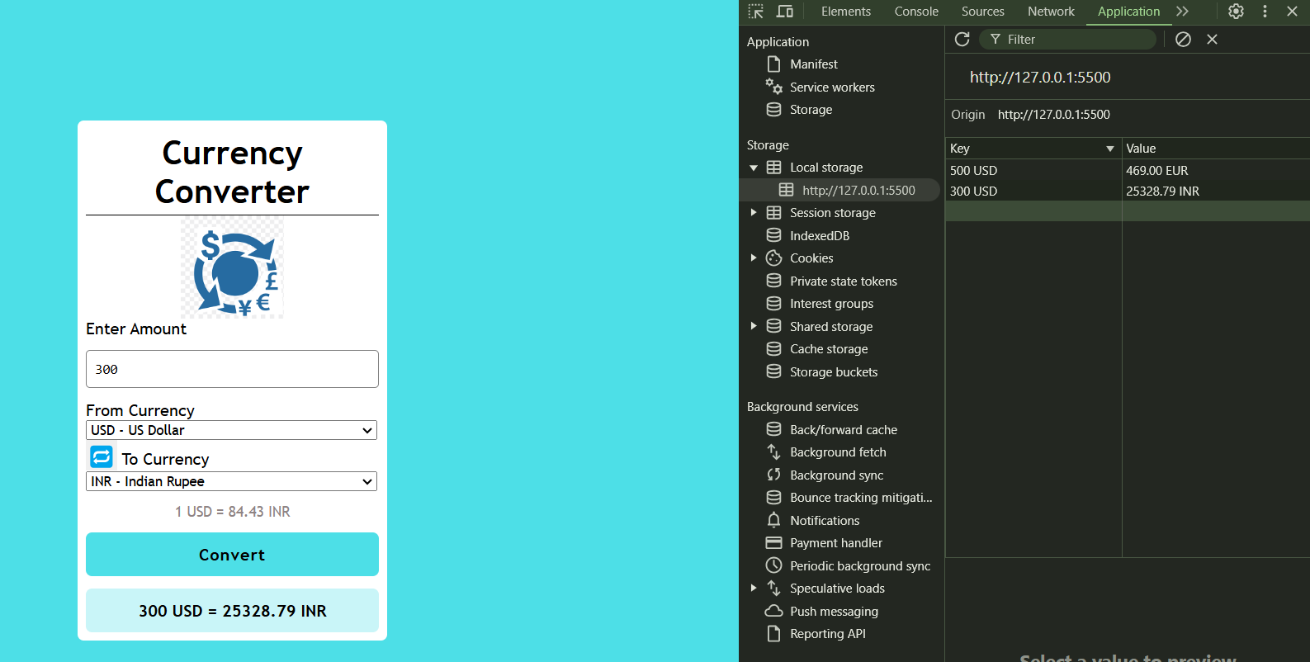
Test Case 2: Transaction History Display
Organize a part to show past conversion after every currency conversion.
Extend the `convertAmount()` function by adding the functionality of logging the conversion into the history.
Each entry to be completed with the source/target currencies, amount and date/time.
Depends on `localStorage` to log history and be not lost upon page or application reloads.
Notes:
SN:Test case therefore confirms that every exchange to and from a currency is recorded with as much detail as what the source and target currencies are, the amount to be converted, and time of conversion. Moreover, several transactions can be preserved in order to be available after the page reload.

Slide 7
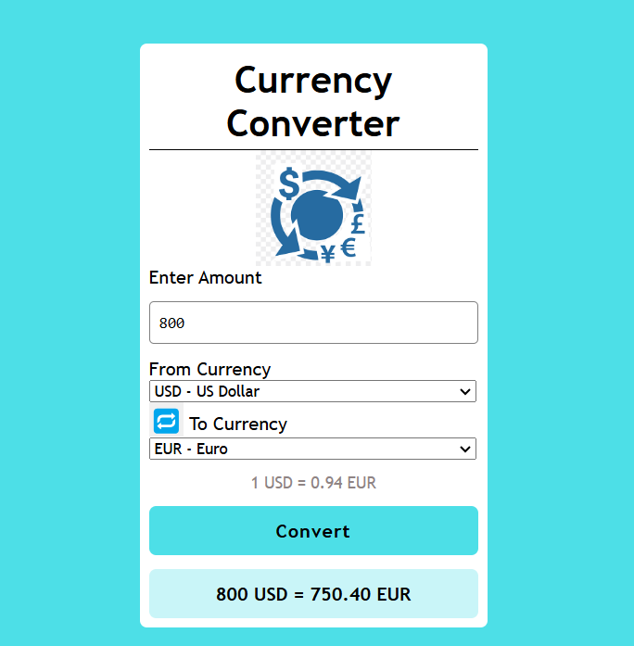
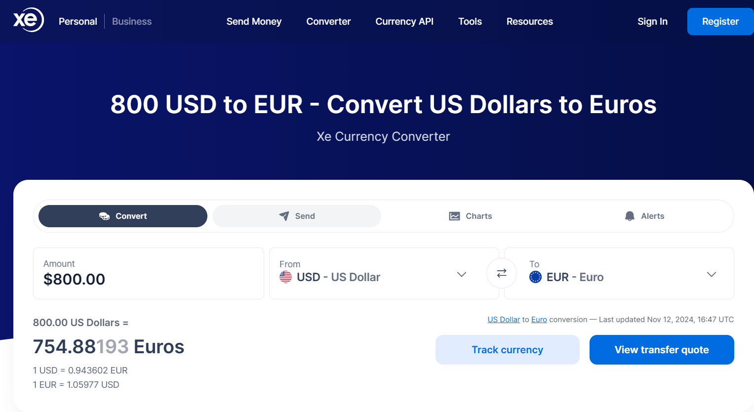
Make sure the “Get Data” button leads to a function that retrieves real-time data from the API.
The function used for this call is `fetchData`, which fetches the live currency data from the exchange rate API (Goh, Ho, and Abas, 2023).
Processing of the exchange rates Upon receiving the data the program should analyze the received exchange rates and format an HTML list of currency rates in a form of <ul> … </ul>.
Show the fetched data in the HTML section within the `#apiData`, with no messy, complex structure with too many combinations or confusing icons.
Use the error handling technique in order to capture problems such as connection problems or API problems and show useful messages to the user interface.
Test Case 3: Fetching Live Currency Rates
Notes:
SN: ‘The next step is to place the ‘Get Data’ button the app, should retrieve live exchange rates from the API and present it in a list format. Make sure that it works without an error and calculates new rates every time.”

Slide 8
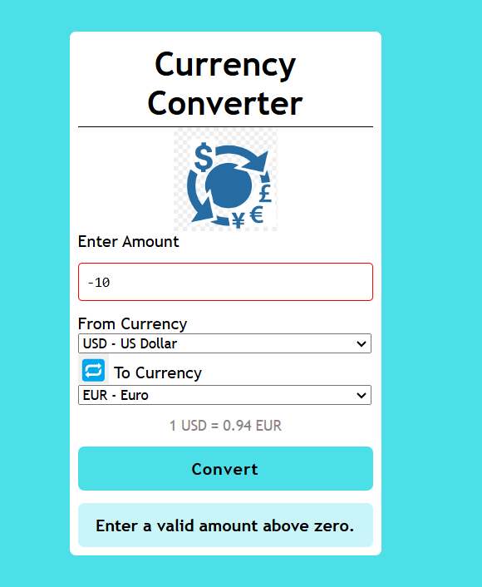
Test Case 4: Invalid Input Handling
Matches for numbers and All Positive Integers meaning greater than 0.
Gives an error message in case input values are entered improperly.
Makes the “Convert” button inactive when there are errors established on the screen.
Clears error state and UI if valid inputs are entered into the form.
Notes:
SN: This enhancement also allows the input of only valid numeric values greater than zero for users. Should theexcel-format input contain an invalid value, an error message appears, and the “Convert” button is disabled until the invalid input is fixed.

Slide 9
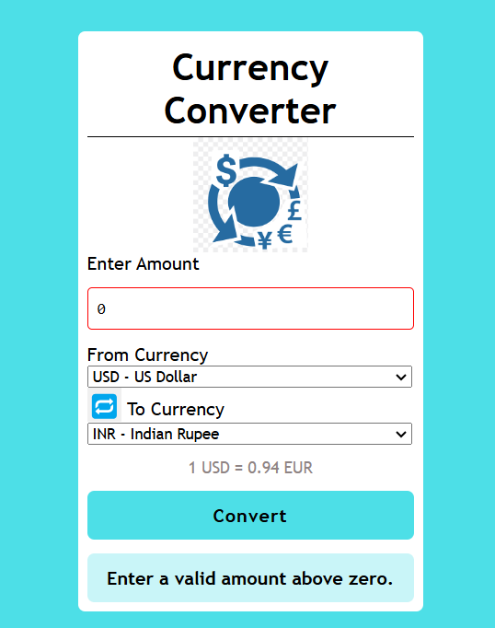
Additional Testing and Dynamic Aspects
Check for correct conversion rates by converting valid input values to desired conversion type.
1
Check the swapping functionality for a set choice of currency (Baidauletov, and Salehin, 2020).
2
Check for non-numeric number, zero or negative values to check the acting of error handling mechanism properly
3
See if the layouts are responsive to either the small screen or use responsive design for better viewing.
4
Notes:
SN: From the functionality perspective, the currency conversion consistency will be checked, input validation will be verified, the swap functionality will be checked and, at last, the responsiveness of the interface on different screens will be tested.

Slide 10
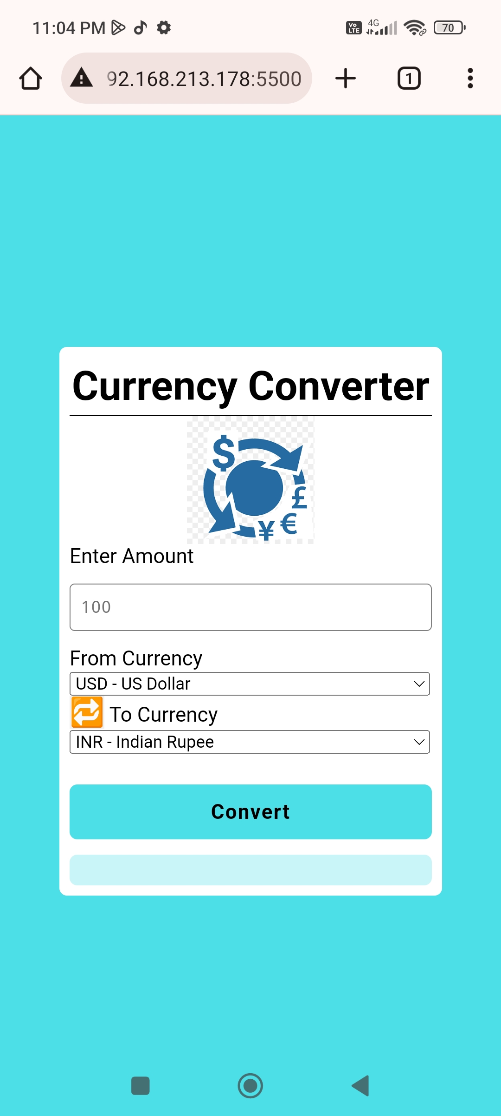
Responsive Design Tests
Make
Make sure the layout changes responsively with the screen resolution available, especially those of mobile, tablet and pc.
Require
Require all elements to adjust correctly the screen size horizontally and vertically without any element overlays or text truncations.
Ensure
Ensure that the check-out buttons and input fields meet the conventional thumb contact on digitally touching mobiles and tablet devices.
Notes:
SN: Responsive design was designed to keep sendoing users on any device and testing the design makes sure that this is achieved. Acknowledging viewport adjustment, sensible layout modification, and touch screen responsiveness guarantees functionality, the users’ accessibility, and the sleek look for both mobile and non-mobile devices.

Slide 11
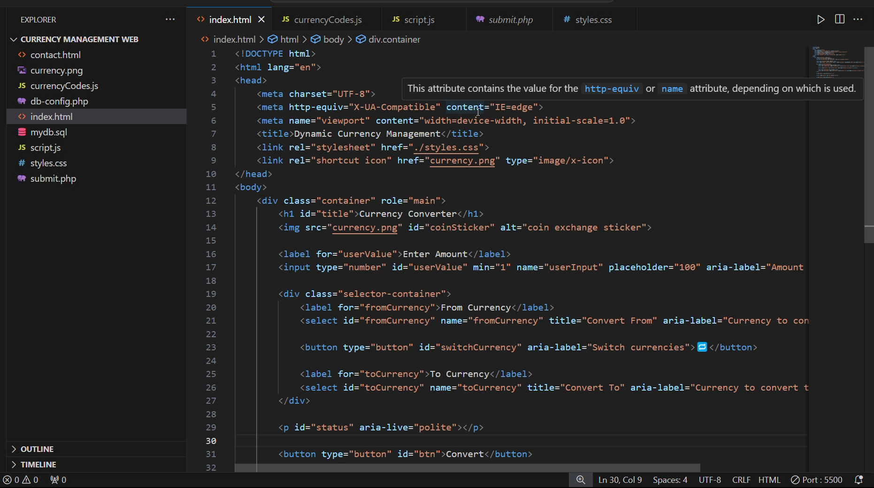

Conclusion and Screencast
The real time currency data is handled effectively in the Currency Management Web Application which is front-end integrated with HTML, CSS and JavaScript and rear-end managed with PHP and MySQL. It would e possible to improve on the interface by incorporating API data updates that refresh in real time and tightening the user login systems.

Slide 12
Reference List
Odeniran, Q., 2023. Comparative Analysis of Fullstack Development Technologies: Frontend, Backend and Database. Retrieved from: https://digitalcommons.georgiasouthern.edu/cgi/viewcontent.cgi?article=3883&context=etd [Retrieved on:25.09.2024]
Goh, H.A., Ho, C.K. and Abas, F.S., 2023. Front-end deep learning web apps development and deployment: a review. Applied Intelligence, 53(12), pp.15923-15945. Retrieved from: https://link.springer.com/article/10.1007/s10489-022-04278-6 [Retrieved on: 25.09.2024]
Baidauletov, D. and Salehin, F., 2020. Integrating Modern Front-end Methodologies and Workflow in the Context of E-commerce Systems. Retrieved from: https://www.theseus.fi/bitstream/handle/10024/334447/Baidauletov%20D.%20%26%20Salehin%20F.%20-%20Integrating%20Modern%20FrontEnd%20Methodologies%20and%20Workflow%20in%20the%20Context%20of%20E-Commerce.pdf?sequence=2[Retrieved on: 25.09.2024]

Slide 13
THANK YOU

